Slide 1
Windows File Systems
Module 8
ITSC205
Operating Systems Internals

Slide 2
Files/Directories structure in Windows
Windows organizes files and directories in a hierarchical order in each partition.
Windows implements a tree file/directory structure
The root of the default partition is C:\ (%SYSTEMROOT%)

Slide 3
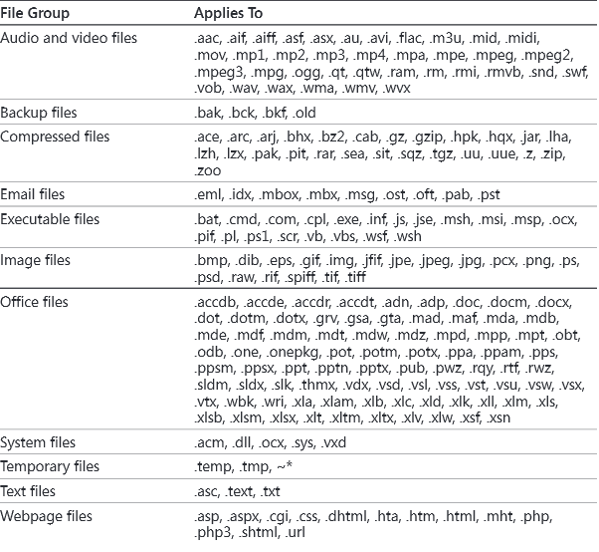
Windows- Types of Files

Slide 4
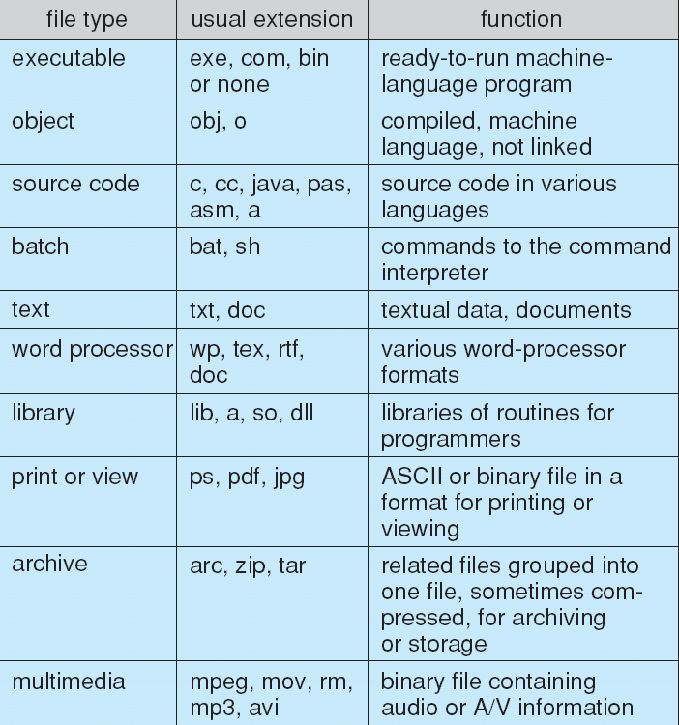
File Types – Name, Extension

Slide 5
Windows File Systems
NTFS
CDFS
UDF
FAT
exFAT
ReFS
Notes:
Read pages 690-694 from text book

Slide 6
Windows File System
The fundamental structure of the Windows file system (NTFS) is a volume, based on a logical disk partition
May occupy a portions of a disk, an entire disk, or span across several disks
All metadata, such as information about the volume, is stored in a regular file
NTFS uses clusters as the underlying unit of disk allocation
A cluster is a number of disk sectors that is a power of two
Why use NTFS instead of FAT? FAT is simpler, making it faster for some operations, but NTFS supports:
Larger file sizes and disks
Better performance on large disks, large directories, and small files
Reliability
Security

Slide 7
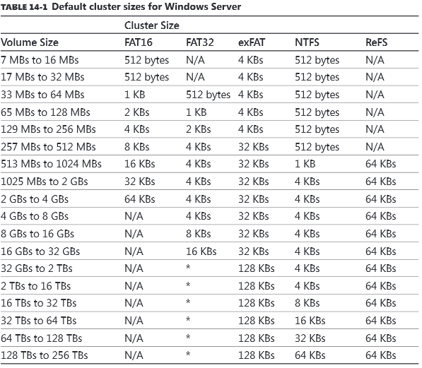
Cluster Sizes

Slide 8
Windows -NTFS
NTFS is the native file system format of Windows and its core is MFT (Master File Table) which contains NTFS metadata
NTFS implements a relational database to store information about files. This database is called the master file table (MFT).
The MFT stores a file record of each file and folder on the volume, pertinent volume information, and details on the MFT itself.

Slide 9

NTFS Volume
Notes:
NTFS Boot Sector Contains the BIOS parameter block that stores information about the layout of the volume and the file system structures, as well as the boot code that loads Windows Server 2003.
Master File Table Contains the information necessary to retrieve files from the NTFS partition, such as the attributes of a file.
File System Data Stores data that is not contained within the Master File Table.
Master File Table Copy Includes copies of the records essential for the recovery of the file system if there is a problem with the original copy.

Slide 10
Master File Table- MFT
MFT is the Heart of NTFS volume structure
Implemented as an array of file records
One row for each file on the volume, including one row for MFT itself
Metadata files store file system structure information (hidden files; $MFT; $Volume...)
http://msdn.microsoft.com/en-us/library/windows/desktop/aa365230(v=vs.85).aspx

Slide 11
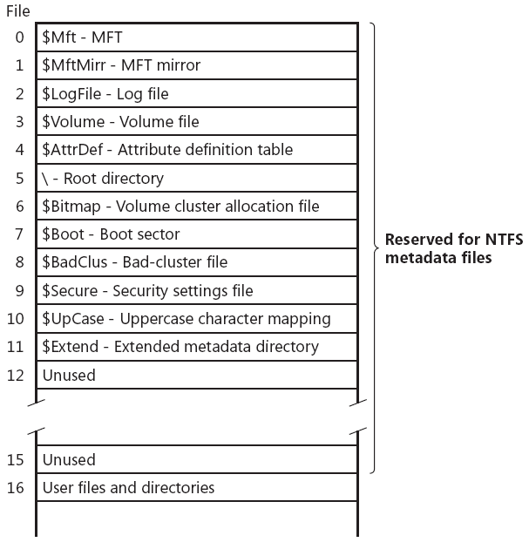
NTFS – Master File Table -MFT
https://image.slidesharecdn.com/bsidesdc-151018213104-lva1-app6891/95/bsidesdc-it-do-it-live-powershell-digital-forensics-22-638.jpg?cb=1445205084
Notes:
Figure 12-24 from text book
In NTFS all data stored in volumes is contained in files to easily locate and maintain the data and each file can be protected by the security descriptor
MFT is implemented as an array of file records
MFT contains one record for each file on the volume, including a record for MFT itself.
MFT metadata start with $. These data is used to implement file system structure
Read Page 733 Master File Table

Slide 12
NTFS – MFT Metadata
NTFS writes to log file ($LogFile)
Record all commands that change volume structure
Root directory:
When NTFS tries to open a file, it starts search in the root directory
Once the file is found, NTFS stores the file‘s MFT file reference
Subsequent read/write operations. may access file‘s MFT record directly
Bitmap file ($Bitmap):
stores allocation state volume; each bit represents one cluster

Slide 13
NTFS – MFT Metadata
Boot file ($Boot):
Stores bootstrap code
Has to be located at special disk address
Bad-cluster file ($BadClus)
Records bad spots on the disk
Volume file ($Volume)
Contains: volume name, NTFS version
Bit, which indicates whether volume is corrupted
Attribute Definition Table ($AttrDef)
Defines attribute types supported on the volume
Indicates whether they can be indexed, recovered, etc.
https://image.slidesharecdn.com/bsidesdc-151018213104-lva1-app6891/95/bsidesdc-it-do-it-live-powershell-digital-forensics-21-638.jpg?cb=1445205084

Slide 14
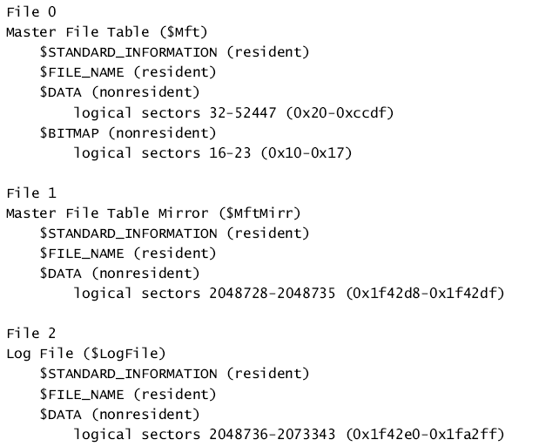
MFT File Records

Slide 15
File Records
NTFS stores files as a Attribute/Value pairs
Each file attribute is stored as a separate stream of bytes within a file
Attributes for NTFS Files e.g
$FILE_NAME
$SECURITY_DESCRIPTOR
$DATA
$INDEX_ROOT
$INDEX_ALLOCATION
$OBJECT_ID

Slide 16
MFT record for a small file
Master File Table
Standard information
Security descriptor
Filename
Data
MFT record for a small file
https://www.google.ca/search?q=master+file+table+by+jared+atkinson&tbm=isch&tbo=u&source=univ&sa=X&ved=0ahUKEwjirenqw-faAhUPx58KHVZUAy4QsAQIVA&biw=1047&bih=488#imgrc=OHR-GSlggF3uUM:

Slide 17
MFT for small directory
Small directory:
index root attribute contains index of file references for files and subdirectories
If file attribute does not fit into MFT:
NTFS allocates separate cluster (run, extent) to store the values
NTFS allocates additional runs if an attribute‘s value later grows
Those attributes are called “non-resident“
Standard info
NTFS filename
Security desc.
Index root
Empty
Index of files
file1, file2, file3,...
MFT file record for a small directory

Slide 18
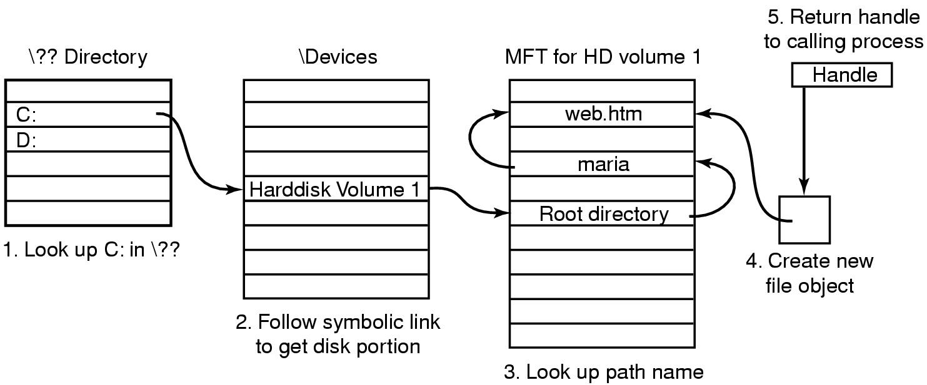
File Name Lookup in W2K
Notes:
When a user program wants to open a file, it typically makes a call like
CreateFile(“C:\maria\web.htm”,…) , this call goes to the user-level shared library, kernel32.dll, where \?? Is appended to the file name giving
\??\C:\maria\web.htm
It is this name that is passed as a parameter to the system call NtFileCreate.
Then the OS starts the search at the root of the object manager’s name space. It then looks in the directory \?? To find C:. This file is a symbolic link to another part of the object manager’s name space, the directory \Device. The link typically ends at an object whose name is something like :
\Device\HarddiskVolume1. This object corresponds to the first partition of the first hard disk. From this object it is possible to determine which MFT to use.
The string ‘maria’ is now looked up in the root directory, which returns the index into the MFT for the directory maria. The directory is then searched for the string “web.htm”. If successful, the result is a new object created by the object manager. The object, which is unnamed, contains the index of the MFT record for the file. A handle to this object is returned to the calling process. On subsequent ReadFile calls, the handle is provided, which allows the object manager to find the index and then the contents of the MFT record for the file.
Reference: Andrew Tanenbaum, Modern Operating Systems

Slide 19
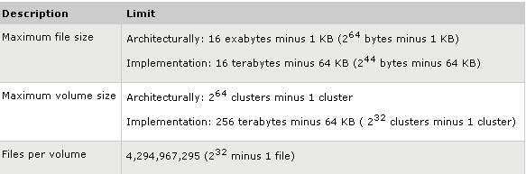
NTFS Size Limitations

Slide 20
Advanced NTFS Features
Sparse files
Hard links
Volume mount points
Multiple data streams
Large disks and large files
Quotas -Disk quotas restrict the amount of volume space users take up on remote or local computers with NTFS file systems.
Security
Notes:
NTFS extends capabilities of FAT file systems by adding:
File system recovery for quick restoration of disk-based data.
Ability to handle large storage media
Security features, including execute-only files.
Unicode filenames.
Support for the POSIX OS.
Features for future extensibility (e.g., transaction-based operations for fault-tolerant applications, user-controlled version numbers, multiple data streams per file, flexible options for file naming/ attributes, and support for popular file servers.)
Windows implements a form of symbolic links called , shortcuts (pointer to files or folders).
The NTFS implements a two- level hierarchy. The contents of short files are kept directly in the file descriptor. For longer files, the descriptor contains lists of block numbers where the actual data is kept.
The native file system , NTFS, of W2K describes each file and each directory using a descriptor of 1 KB. When the number of a file entries (each consisting of a file name and an index to a file descriptor) exceeds the length of the 1 KB descriptor additional block sequences called runs are allocated. The runs are organized in the form of a B+ tree.

Slide 21
Hard Links
A hard link is an NTFS-only based link to a given file. When you create a hard link to a file on an NTFS volume, NTFS adds a directory entry for the hard link without duplicating the original file. By creating hard links you can:
Use the same file name as the original file and appear in different folders.
Use different file names from the original file and appear in the same folder.
Use different file names from the original file and appear in different folders.
Notes:
Because a hard link is a directory entry for a file, an application can modify a file by using any of its hard links. Applications that use any other hard link can detect the changes. However, directory entries for hard links are updated only when a user accesses a file by using the hard link. For example, if a user opens and modifies a file by using its hard link, and the size of the original file changes, the hard link that is used to access the file also shows the new size.
Hard links do not have security descriptors; instead, the security descriptor belongs to the original file to which the hard link points. Thus, if you change the security descriptor of any hard link, you actually change the underlying file’s security descriptor. All hard links that point to the file allow the newly specified access. You cannot give a file different security descriptors on a per-hard-link basis.
Hard links use the Win32 function CreateHardLink to create hard links between files.

Slide 22
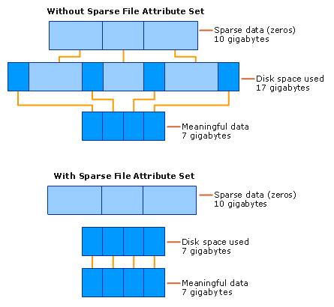
Sparse Files
Notes:
Sparse files provide a method of saving disk space for files that contain meaningful data, as well as large sections of data composed of zeros. If an NTFS file is marked as sparse, then NTFS allocates disk clusters only for the data explicitly specified by the application. Non-specified ranges of the file are represented by non-allocated space on the disk. When a sparse file is read from allocated ranges, the data is returned as it was stored. Data read from non-allocated ranges is returned as zeros.
File system application programming interfaces (APIs) allow for the file to be copied or backed as actual bits and sparse stream ranges.
File system APIs also allow for querying allocated ranges. Programs that implement these APIs then need only to read allocated ranges to recover all data in the file. The result is efficient file system storage and access. The figure Sparse Data Storage shows how data is stored with and without the sparse file attribute set.

Slide 23
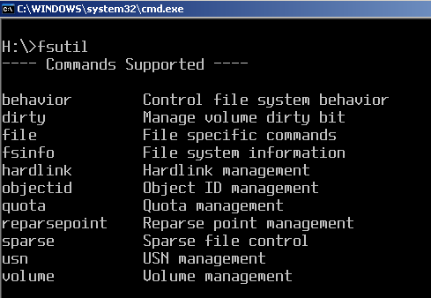
Windows utility - fsutil

Slide 24
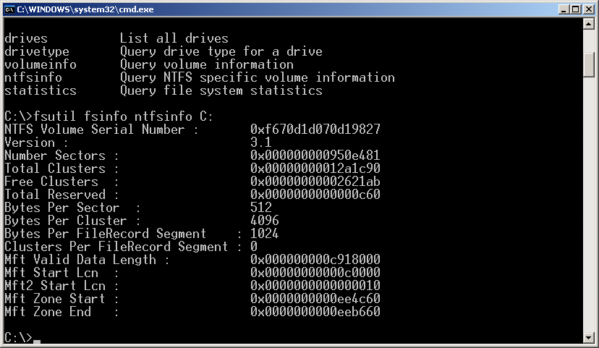
Windows utility - fsutil

Slide 25
Volume Mount Point
Any volume or partition can be mounted to an empty NTFS folder as long as the folder is on a fixed disk drive rather than a removable media drive.
A volume or partition mounted in such a way is called a mount point
Each volume or partition can have multiple mount points associated with it.

Slide 26

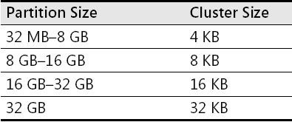
FAT - Format Organization
Default Cluster Sizes for FAT 32 Volumes
Notes:
FAT 32 can address up to 8TB, but Windows limits FAT32 volumes to 32GB.
FAT32 can manage up to 128 volumes with 512 bytes cluster.
FAT32 root directory is not stored in a specific location on the volume.
FAT32 have a copy of boot sector for reliability.
FAT32 disadvantage is maximum file size is 4GB.
Windows XP supports FAT 32 on DVD-RAM devices.

Slide 27
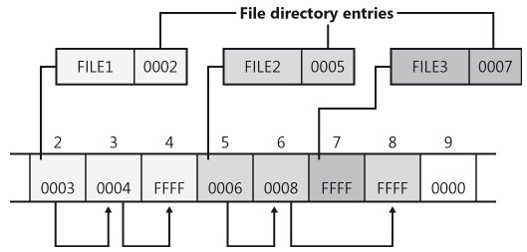
FAT –Directory Entry Example

Slide 28
Virtual File Systems
Virtual File Systems (VFS) on Unix provide an object-oriented way of implementing file systems. It is compatible with other File Systems
VFS allows the same system call interface (the API) to be used for different types of file systems
Separates file-system generic operations from implementation details
Implementation can be one of many file systems types, or network file system

Slide 29
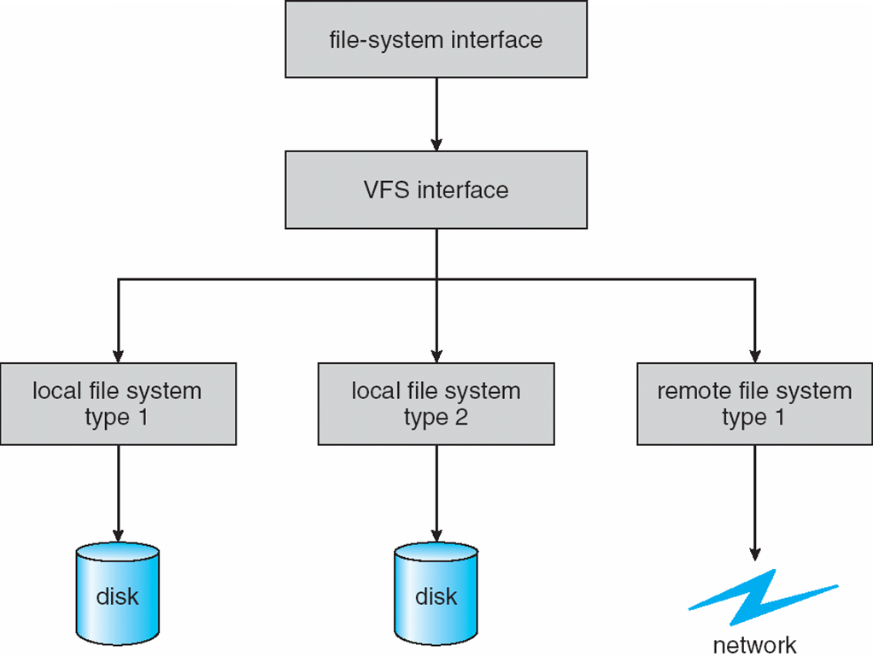
Schematic View of Virtual File System

Slide 30
Allocation Methods
An allocation method refers to how disk blocks are allocated for files:
The Allocation methods are:
Contiguous
Linked
Index

Slide 31
Contiguous Allocation
Contiguous allocation – each file occupies set of contiguous blocks
Best performance in most cases
Simple – only starting location (block #) and length (number of blocks) are required
Problems includes:
finding space for file,
knowing file size,
external fragmentation.

Slide 32
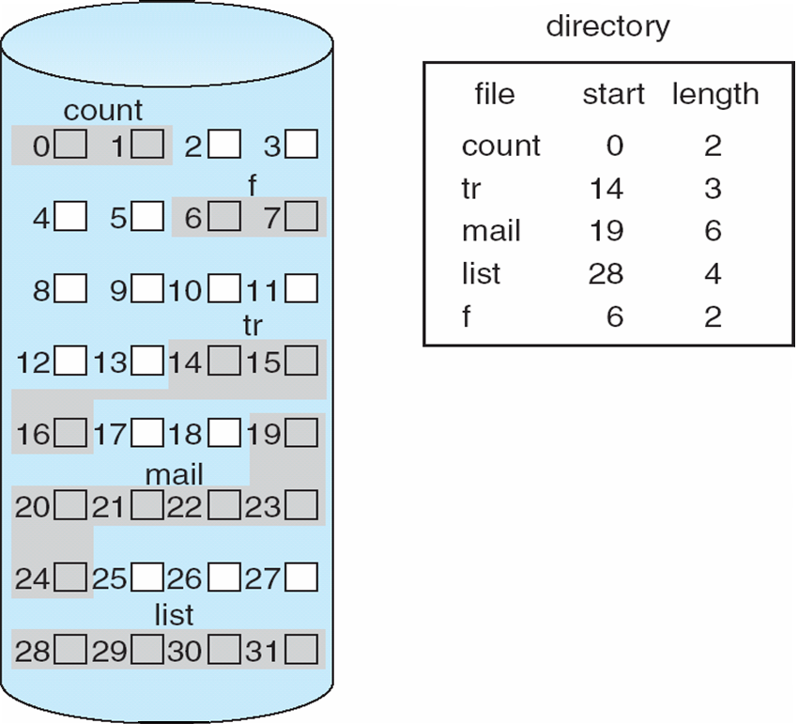
Contiguous Allocation of Disk Space

Slide 33
Extent-Based Systems
Many newer file systems (i.e., ext4 ,Veritas File System) use a modified contiguous allocation scheme
Extent-based file systems allocate disk blocks in extents
An extent is a contiguous block of disks
Extents are allocated for file allocation
A file consists of one or more extents

Slide 34
Linked Allocation
Linked allocation – each file a linked list of blocks
File ends at nil pointer
No external fragmentation
Each block contains pointer to next block
Free space management system called when new block needed
Improve efficiency by clustering blocks into groups but increases internal fragmentation
Locating a block can take many I/Os and disk seeks

Slide 35
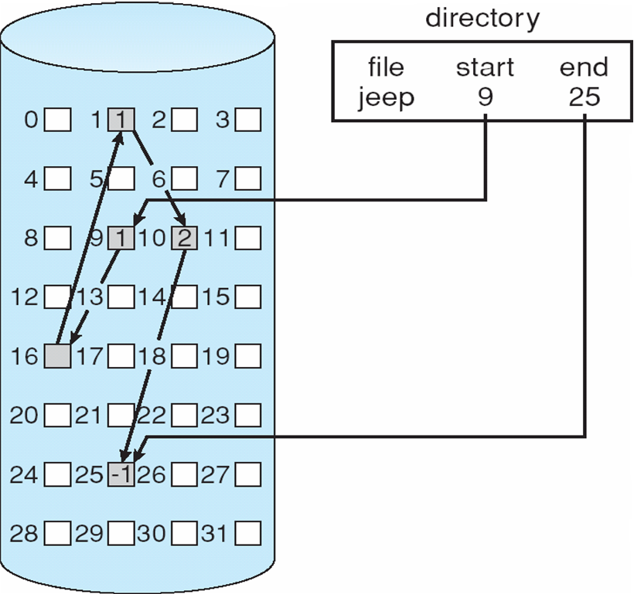
Linked Allocation

Slide 36
FAT is an e.g. of Linked Allocation
FAT (File Allocation Table) file systems are a legacy format that originated in DOS and Windows 9x
Reasons why Windows supports FAT file systems:
to enable upgrades from other versions of Windows
compatibility with other operating systems in multiboot systems
Each FAT format includes a number that indicates the number of bits the format uses to identify clusters on a disk
Boot sector
File allocation table 1
File allocation table 2 (duplicate)
Root directory
Other directories and all files

Slide 37
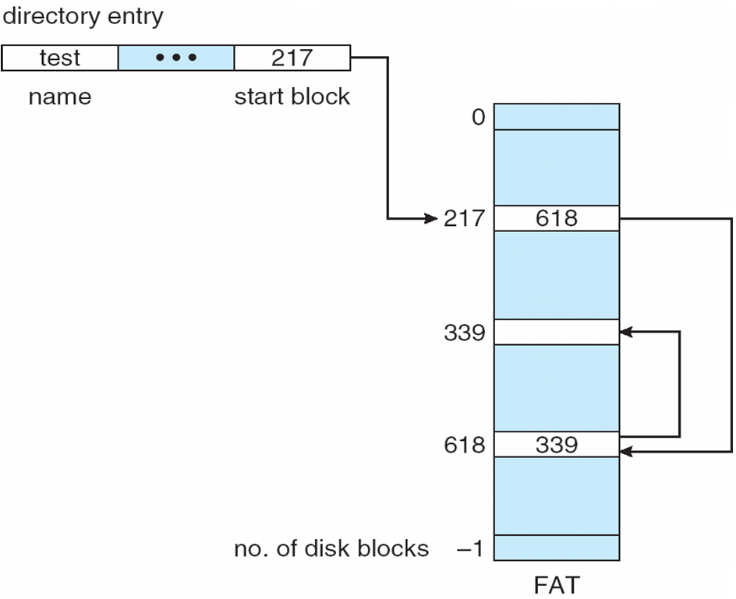
File-Allocation Table

Slide 38
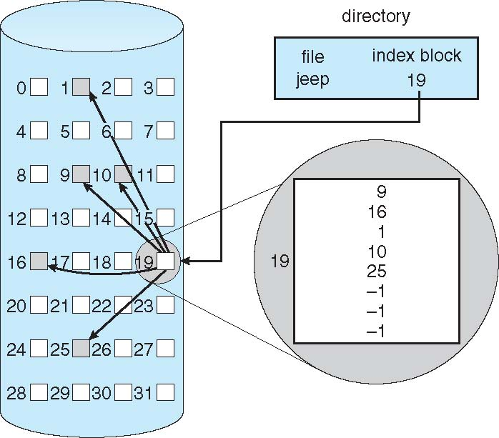
Example of Indexed Allocation

Slide 39
Log Structured File Systems
Log structured or journaling file systems record each metadata update to the file system as a transaction
All transactions are written to a log file
A transaction is considered committed once it is written to the log (sequentially)
Sometimes to a separate device or section of disk
However, the file system may not yet be updated
The transactions in the log are asynchronously written to the file system structures
When the file system structures are modified, the transaction is removed from the log
If the file system crashes, all remaining transactions in the log must still be performed
Faster recovery from crash, removes chance of inconsistency of metadata

Slide 40
File System — Recovery
All file system data structure updates are performed inside transactions that are logged.
Before a data structure is altered, the transaction writes a log record that contains redo and undo information.
After the data structure has been changed, a commit record is written to the log to signify that the transaction succeeded.
After a crash, the file system data structures can be restored to a consistent state by processing the log records.
This scheme does not guarantee that all the user file data can be recovered after a crash, just that the file system data structures (the metadata files) are undamaged and reflect some consistent state prior to the crash.
The log is stored in the third metadata file at the beginning of the volume.

Slide 41
Journal Entries
https://www.dfir.training/infographic/291-usnjrnl-j/file

Slide 42
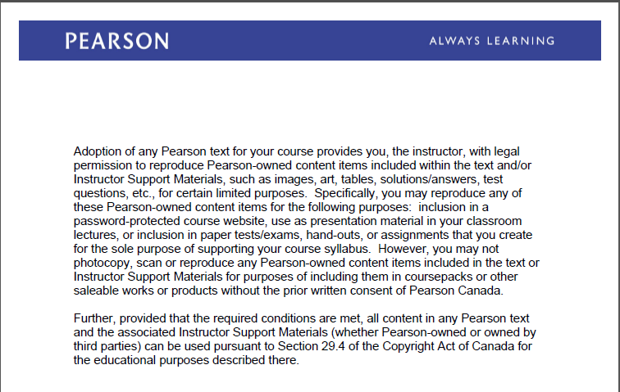
Text Book Slides – Copy Right

